Slide 1
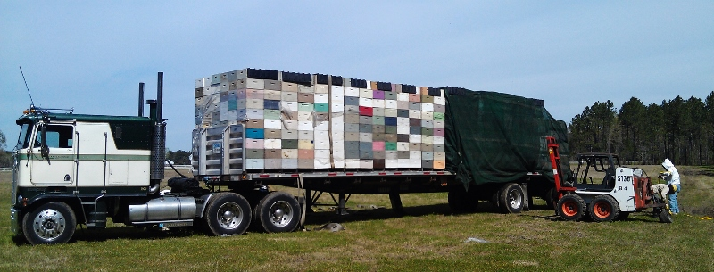
Home sick: Effects of migratory beekeeping on honey bee disease
---
P. Alexander Burnham, Samantha Alger, Leif Richardson & Zachary Lamas
keychainlogistics.com

Slide 2
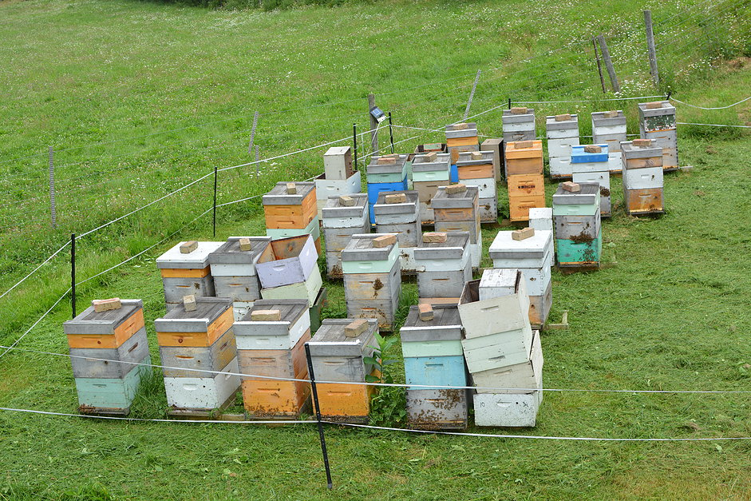
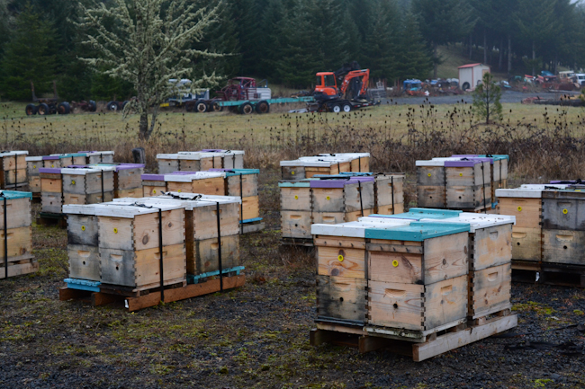
Two Main Types of Bee Operations…
Stationary Apiaries:
Migratory Apiaries:
&
bedillionhoneyfarm.com
waywardspark.com

Slide 3
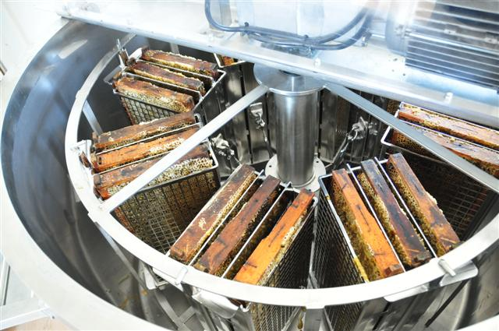
Stationary
Honey Production
Queen Breeding
Selling Nucs
Pollination
coxhoney.com

Slide 4
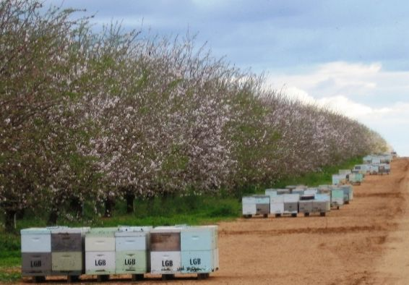
Migratory
Pollination Contracts
Almonds
Canola
Blueberries etc.
~60% of US colonies pollinate almonds
$14.6 Bil. industry
(Cavigli et al., 2016)
Australian Broadcasting Co.
(Morse & Calderone, 2000)

Slide 5
Anecdotally, some people believe that migratory beekeeping leads to unhealthy bees
WHY?

Slide 6


Spread of Disease
Big Cities (migratory):
-high disease transmission
Small Towns (stationary):
-low disease transmission
huffingtonpost.com

Slide 7
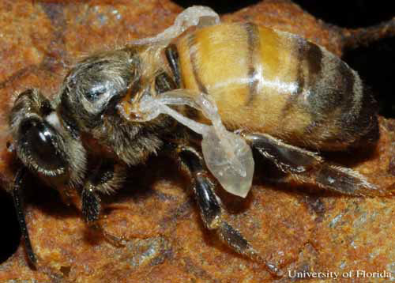
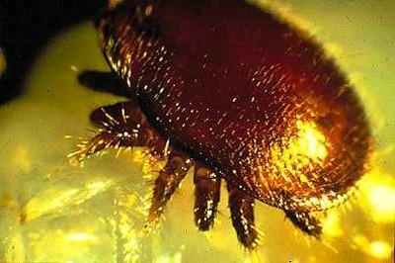
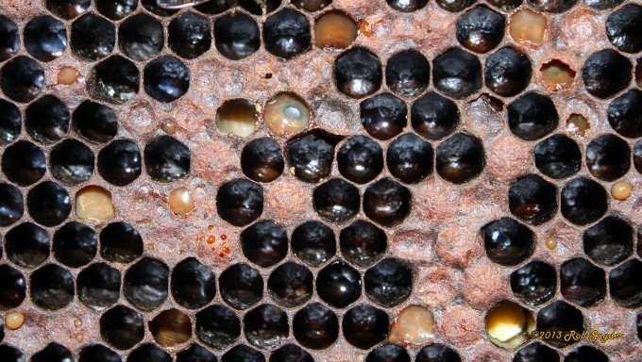
Honey Bee Pathogens:
VIRUSES:
Deformed Wing Virus (DWV)
Black Queen Cell Virus (BQCV)
Sac Brood Virus (SBV)
PARASITES:
Nosema (ceranae & apis)
Varroa Mite
OTHER PATHOGENS & Pests:
American Foulbrood (AFB)
European Foulbrood (EFB)
Chalk Brood
Black shiny bee
Small Hive Beetle
Deformed wing Virus
University of Florida,
Entomology Dept.
Varroa destructor
North Carolina State University,
Cooperative Extension
American Foulbrood
Bee Informed Partnership

Slide 8
The big question!
“Do migratory operations contribute to the spread of honeybee disease?”

Slide 9
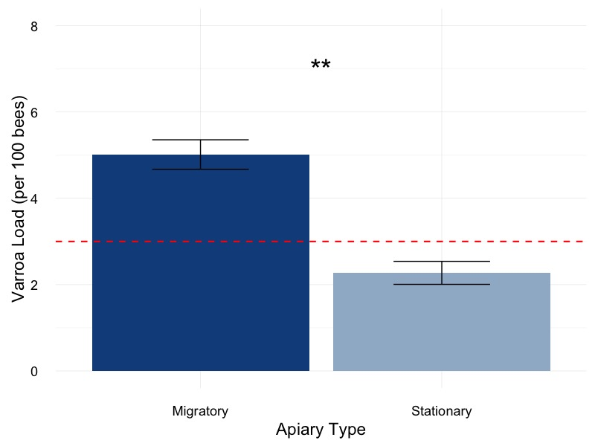
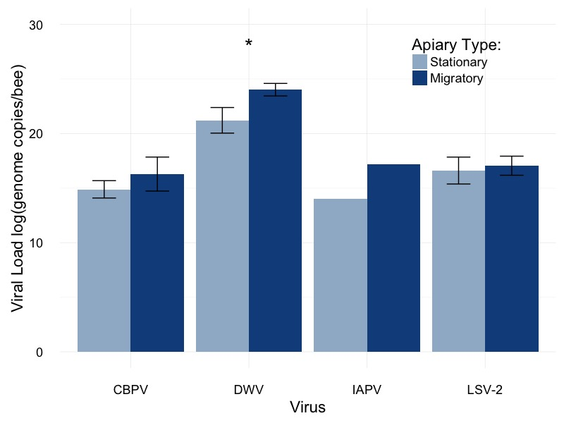
Preliminary Data from the National Honey Bee Survey in Vermont…
Varroa Mites:
RNA Viruses:

Slide 10
What other people have found:
Migratory operations can have high disease loads
Infected hives may transmit disease to other bees
Varroa loads can be lower in migratory bees
These data are correlative:
Surveys
Observational studies
(Welch et al., 2009; Cavigli et al., 2016)
(Fürst et al., 2014)
(NHBS report, 2016)

Slide 11
These data are correlative
When Shark attacks go up, ice cream sales go up
Shark Attacks don’t cause ice cream consumption
Eating ice cream doesn't make you an easier target for a shark
In the summer more people order ice cream and more people are at the beach because it’s hot
= Ice Cream Sales
= Shark Attacks
Frequency
Winter Spring Summer Fall
Season

Slide 12
To test a hypothesis, we need to conduct an experiment:
A
B
Causes
OR
B
A
Causes
OR
A
B
Causes

Slide 13
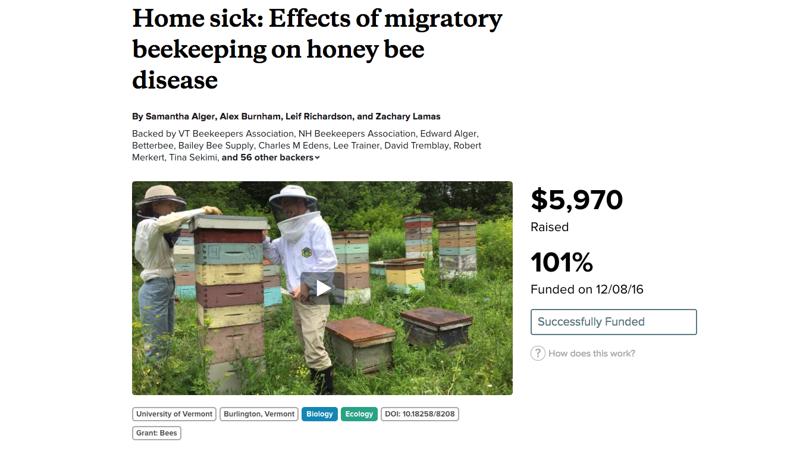

Slide 14
Our Hypotheses
Two parts to this experiment:
Question I: Do migratory colonies have higher pathogen levels than stationary colonies?
Question II: Can migratory colonies infect stationary colonies upon their return?

Slide 15
Experimental Design
Three groups of colonies:
Migratory
Stationary (control)
Stationary (exposed)
Each group contains 16 colonies
Sampled at three different times
Analyzed at our lab at UVM

Slide 16


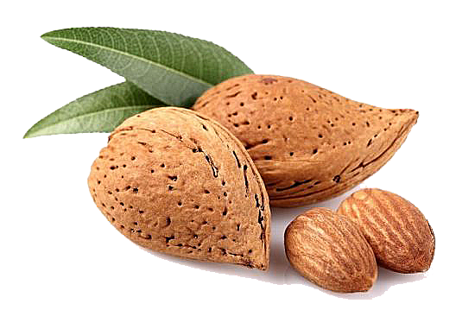
Experimental Design for Migratory/Stationary Honey Bee Experiment Part I
CA
NC
Migratory Group
Migratory Group
Stationary Group
- Do migratory colonies have higher pathogen levels than stationary colonies?

Slide 17
Experimental Design for Migratory/Stationary Honey Bee Experiment Part II
CA
NC
Exposed Group
Stationary Group
Migratory Group
- Can migratory colonies infect stationary colonies upon their return?

Slide 18
Discussion
The purpose of this study is NOT to assign blame to migratory beekeeping.
Migratory beekeeping is very important for our agriculture and economy.
We hope to learn more about how beekeeping practices play into transmission and bee health.

Slide 19
Implications
Grow apiary inspection programs
Fund pathogen monitoring programs to ensure that new diseases don’t get introduced.
Adjustments to management practices

Slide 20





Acknowledgments
Samantha Alger
Leif Richardson
Zachary Lamas

Slide 21
And Most of all, our Backers…
VT Beekeepers Association, NH Beekeepers Association, Edward Alger, Betterbee, Bailey Bee Supply, Charles M Edens, Lee Trainer, David Tremblay, Robert Merkert, Tina Sekimi, Mike Kiernan, Sandra Tomlinson, Amy Handy, Joe Perry, Luke Manlove, Dan Boisvert, Jacqueline Alger, Dan O'Hanlon, Patrick Gillen, Alison K Brody,Daniel Hall Lipke, Beth Sawyer, Cathy Wilson, Allison Malloy, Richard Reid, Nicole Berthiaume, Heather Achilles, Phyllis E Burnham, Yeager Anderson, Bill Castro, Luke Tilley,Jonathan Alger, Peter Gatehouse, Amy Parachnowitsch, Trevor Brandt, Katie Iles, JESSICA PAGANO, Kate Protagonist, Andrea Stanley, Robert Zywno, Helmut Besser, Allen Turechek,Adrian Adam Zywno, Kirsten Shoshanna Traynor, Meghan O'Rourke, Jean McCartin, Ben Ritchie, Vicki Anne, Hollis Woodard, James DeRosia, The Backyard Farm, Malcolm Hobbs,Aaron Schwartz, Linda Battista, Lauren Ash, Raphaël Royauté, Kay Newhouse, Maggie Davern, Joanne Bryan, Sarah Rommelfanger, Pureum Kim, Luke McCartin, Kendall Johnson,Sara Held, Eric Damon Walters, and Bo Sprotte Kofod

Slide 22
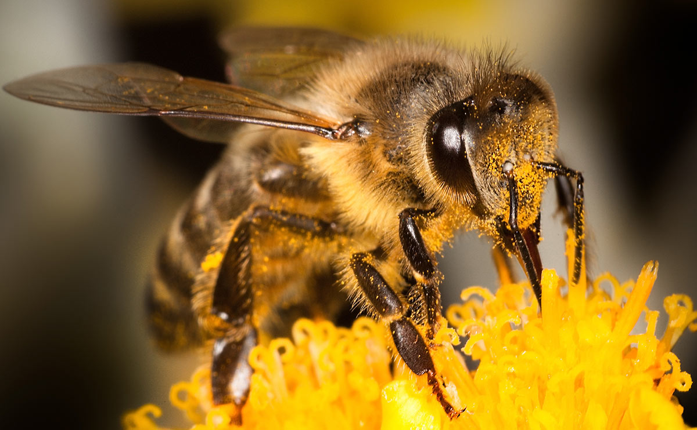
Thank You!

Slide 23
Stay Tuned!

Slide 24
Questions?

